Slide 1
CMPE257 Project Group 2: Predict Future Sales

Slide 2
About the dataset
Source: Predict Future Sales Kaggle competition
Historical sales data of 2,170 items sold by 60 shops between January 2013 to October 2015.
Files description:
sales_train.csv - The training set. Daily historical data from January 2013 to October 2015.
(4 - date, date block num, shop id, item id, item price, count of items sold on the day)
test.csv - The test set, consisting of Shop id and item id.
( 2 - shop name, shop id)
sample_submission.csv - a sample submission file in the correct format.
(2 – index, count of items sold on November 2015)
items.csv - Information about the items/products.
(3 - item name, item id, item category id)
item_categories.csv - supplemental information about the items categories.
(2- item category name, item category id)
shops.csv- supplemental information about the shops.
(2 - shop name, shop id)

Slide 3
Objective
The task is to forecast the total amount of products sold in every shop for the test set.

Slide 4
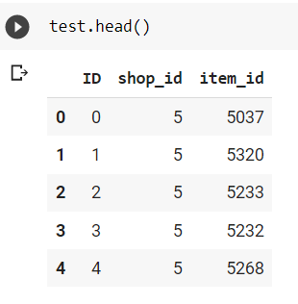
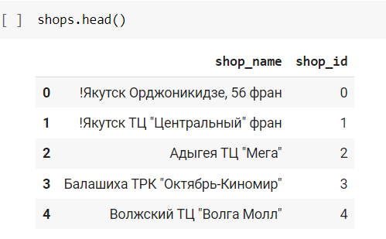
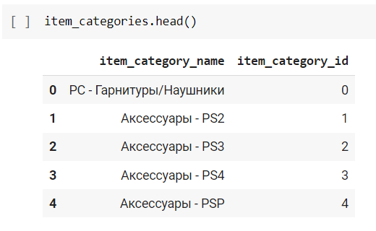
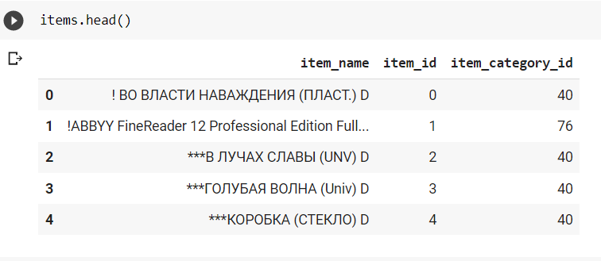
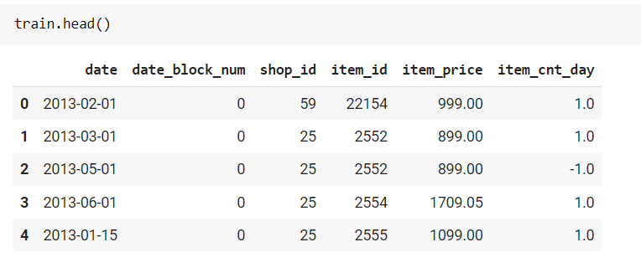
Data Exploration

Slide 5
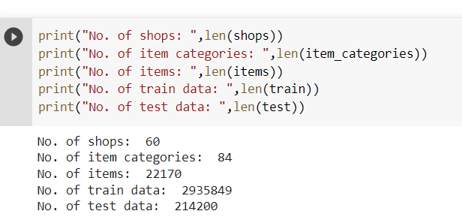
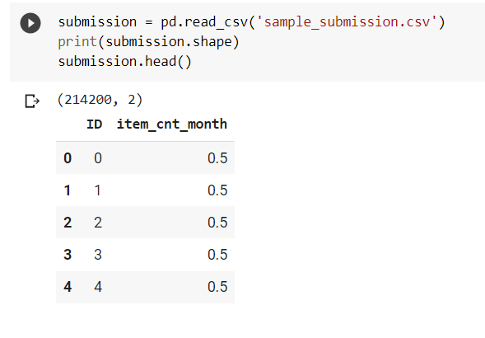
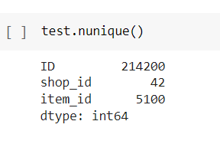
Total samples and Unique values
Unique items in Train set
Shops: 60
Items: 22170
Item category: 84
It appears we only need to forecast sales for 5,100 items for 42 shops.
42 x 5100 = 214200

Slide 6
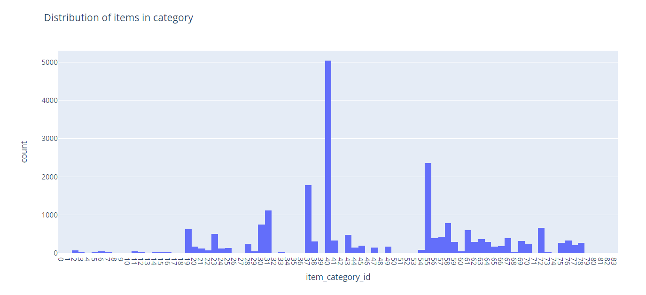
Visualizing data

Slide 7
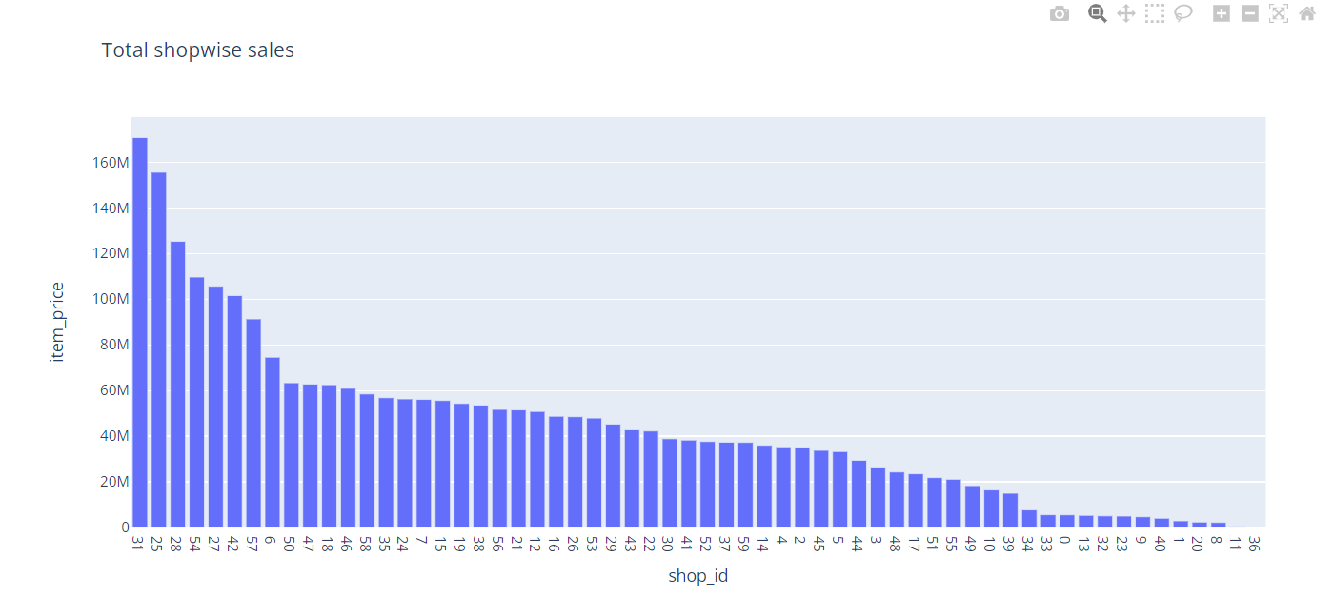

Slide 8
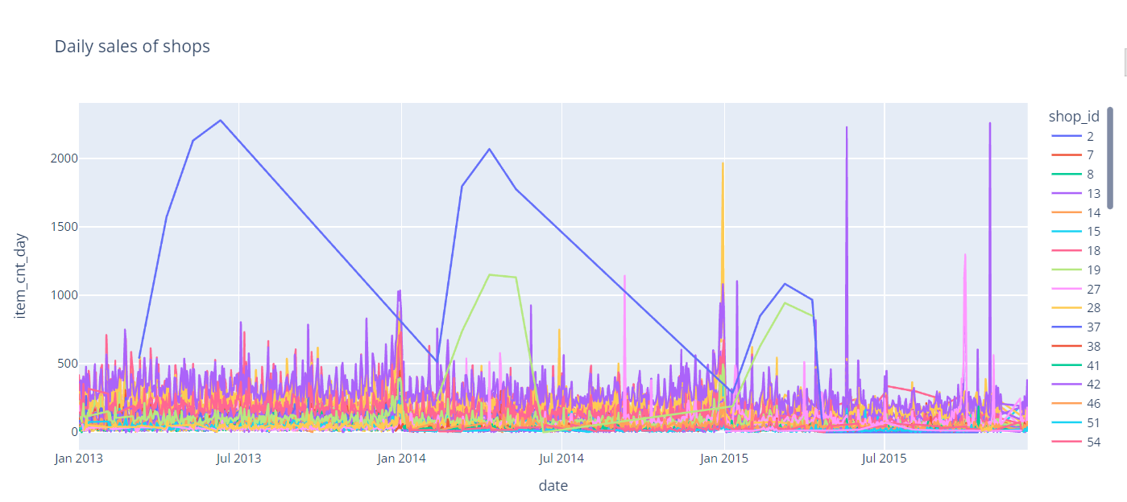

Slide 9
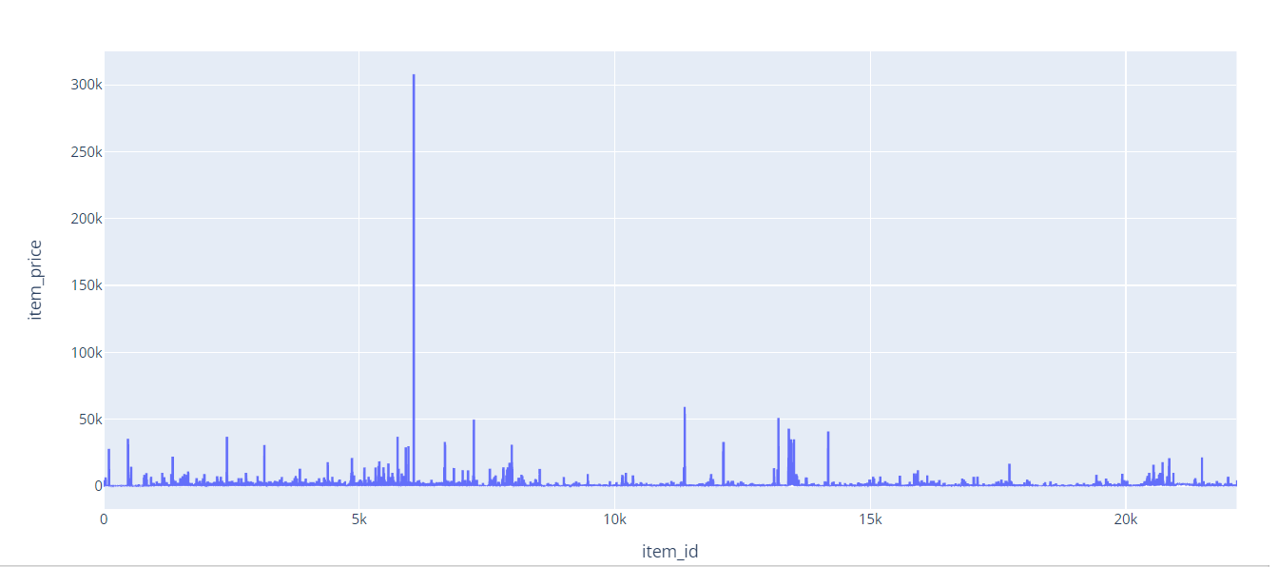
Item price vs Item id plot

Slide 10
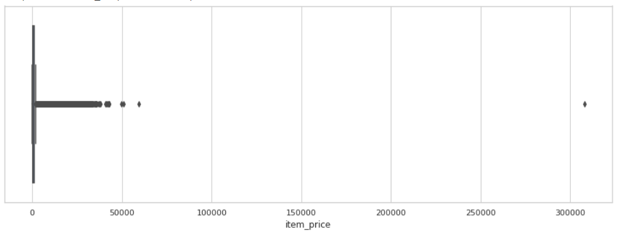
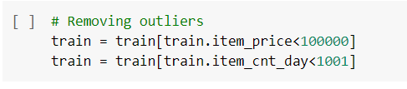
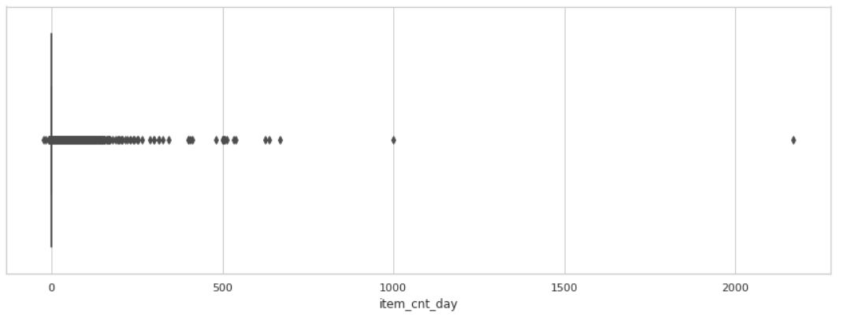
There are some outliers that needs to be treated

Slide 11
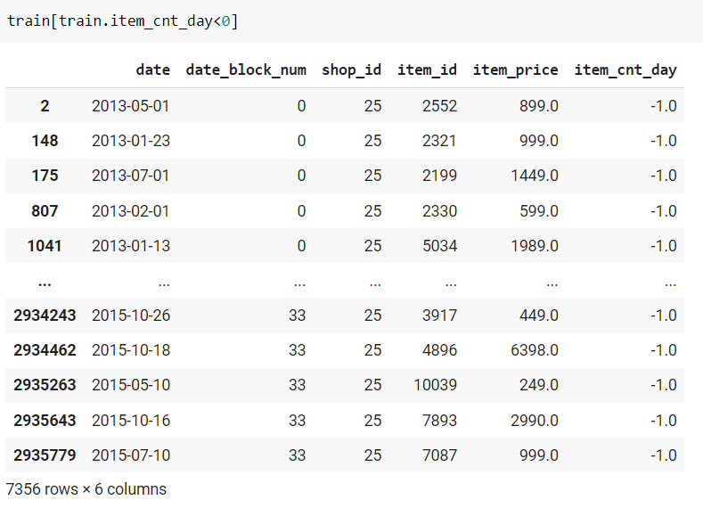
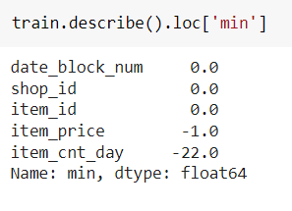
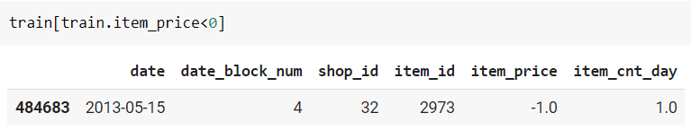
Negative item price and item counts

Slide 12
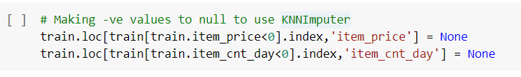
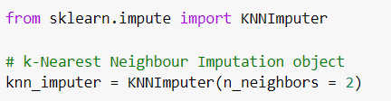
Handling negative values
Making negative values null and imputing them using sklearn KNNImputer

Slide 13
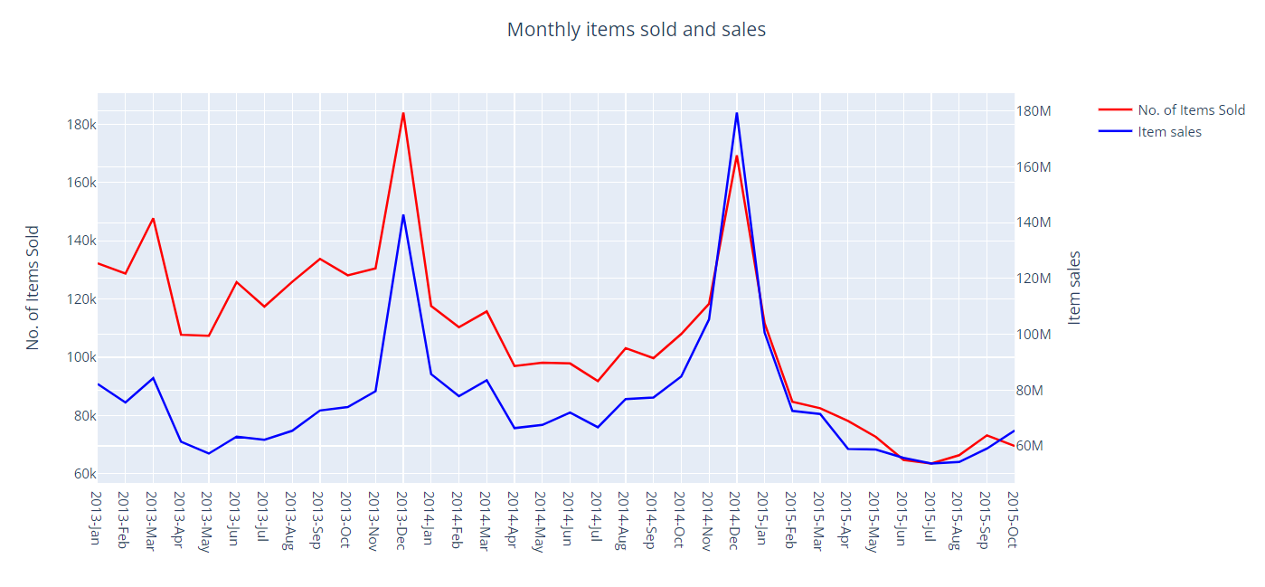
Above graph shows monthly no. items sold and sales made by all shops combined.
We can see there is seasonality in the sales trend. The sales seems to peak in the year end, and then follows a decreasing trend.

Slide 14
Approaches tried
Time Series forecasting using Prophet
SARIMA
XGBoost

Slide 15
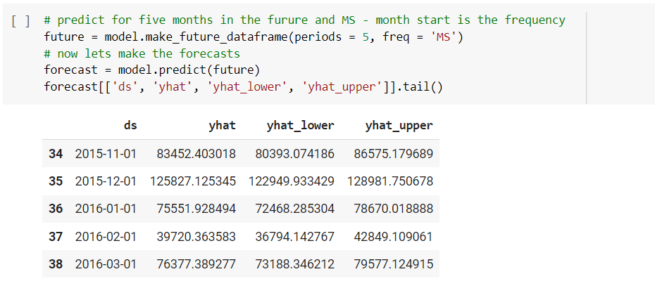
Prophet model
Prophet requires input as a pandas data frame having only 2 columns - 'ds' and ’y’.
‘ds’ column should have the date series and ‘y’ should have corresponding item count values.
Prediction by Prophet for total items sold by every shop in the month of November 2015 (index 34)

Slide 16
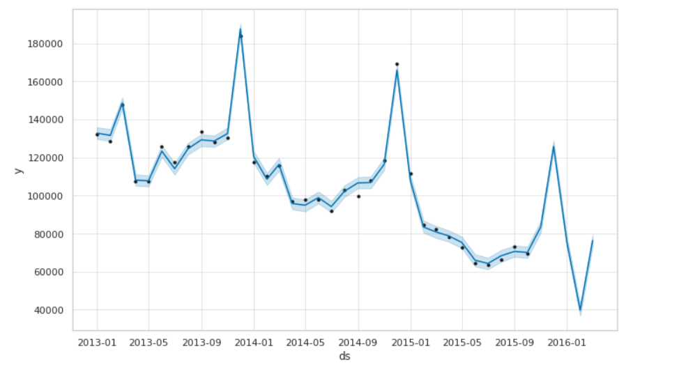
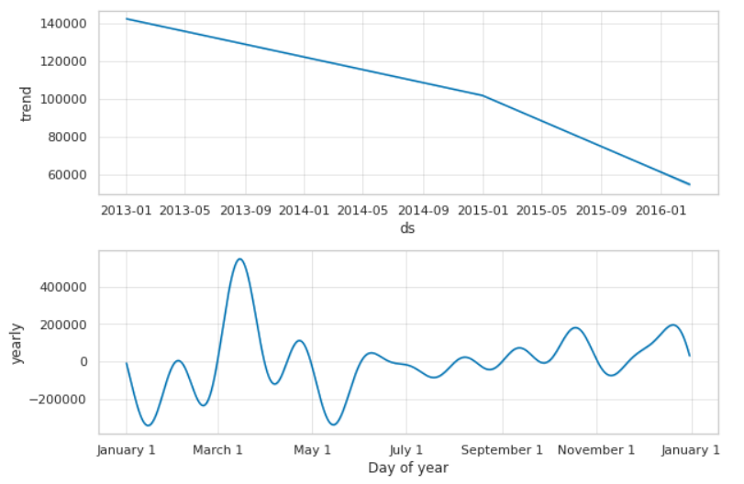
Prediction by Prophet for total items sold by every shop in the month of November 2015

Slide 17
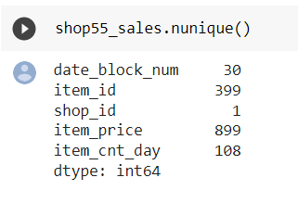
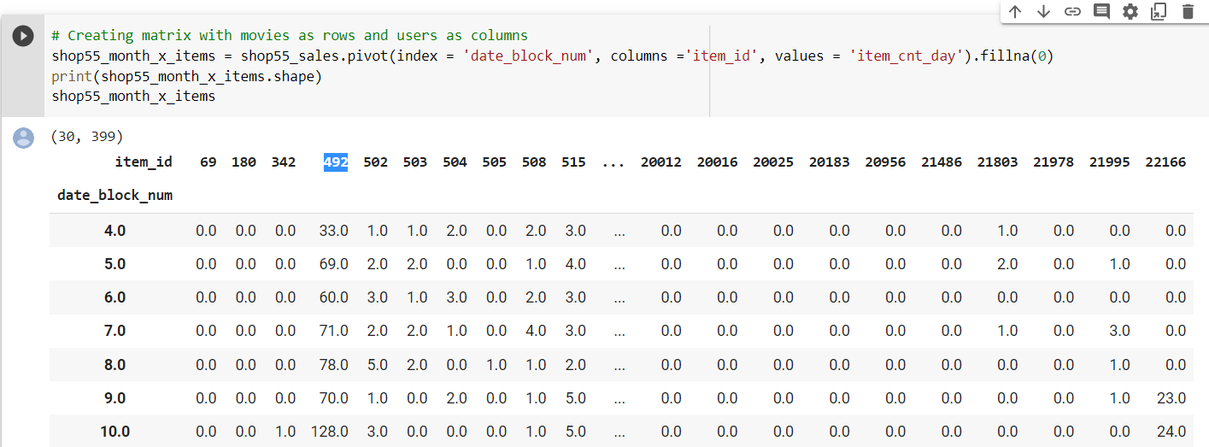
Ex: Predicting item 492 sales for Shop_id 55
Filter for sales of shop 55
Create Month vs Item id matrix having item count
Select time series for 492 item
Fit Prophet model

Slide 18
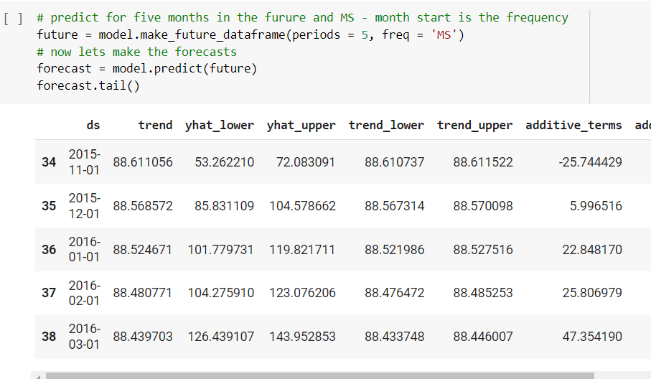
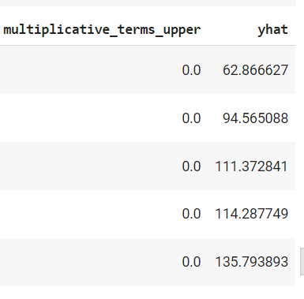
Yhat predictions from Prophet model
…….
…….

Slide 19
LightGBM
Light GBM is a fast, distributed, high-performance gradient boosting framework based on decision tree algorithm. It is designed to be distributed and efficient with the following advantages:
Faster training speed and higher efficiency:
Light GBM uses leaf wise splitting over depth-wise splitting which enables it to converge much faster
Lower memory usage:
Better accuracy.
Support of parallel, distributed, and GPU learning.
Capable of handling large-scale data.
Source: https://lightgbm.readthedocs.io/en/latest/

Slide 20
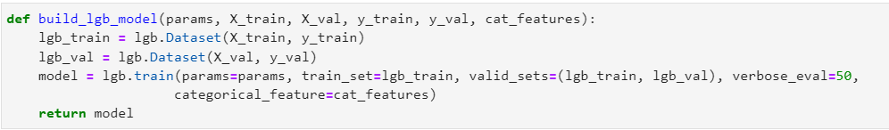
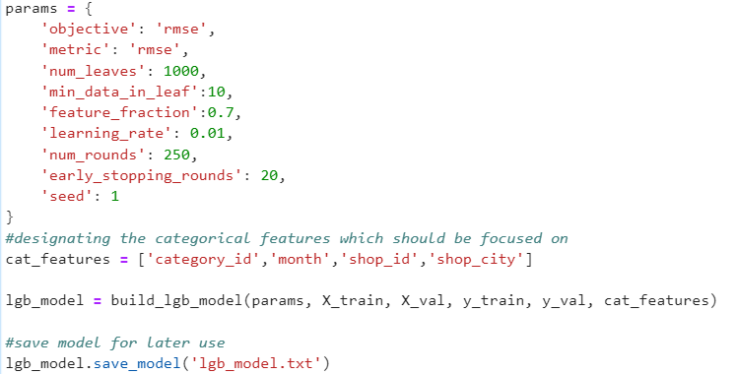
LightGBM Model
num_iterations: number of boosting iterations to be performed ;default=100;
num_leaves : number of leaves in one tree ; default = 31 ; type =int
categorical_feature : categorical features we want to use for training our model

Slide 21
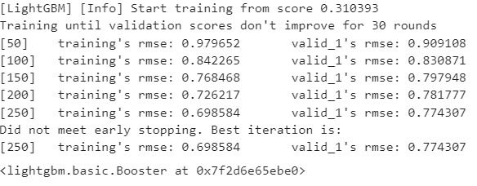
Results

Slide 22
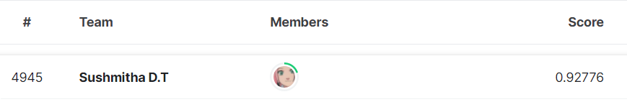
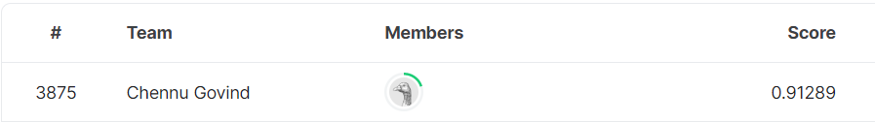
Conclusion
Models tried
Prophet - Takes lot of time for large dataset with multiple time series.
LSTM - Test RMSE: 1.24099. Kaggle ranking 11,400s
LightGBM - Test RMSE: 0.92776. Kaggle ranking: 4945
ARIMA -
XGBoost – Test RMSE: 0.77729. Kaggle ranking 3875

